Slide 1
Background

Slide 2

Project Background
Due to many uncertain factors in the financial market, especially every investment decision made by investors under the guidance of subjective emotions, many investors' decisions are wrong, so quantitative trading comes into being.
The goal of the project is to complete a quantitative trading system. The main purpose of this project is to help users with portfolio selection and asset allocation. Specifically, users can use different strategies and asset allocation methods in the quantitative trading system to select portfolios and back-test the selected portfolio to verify the rate of return of the portfolio.
Notes:
Due to many uncertain factors in the financial market, especially every investment decision made by investors under the guidance of subjective emotions, many investors' decisions are wrong, so quantitative trading comes into being.
The goal of the project is to complete a quantitative trading system. The main purpose of this project is to help users with portfolio selection and asset allocation. Specifically, users can use different strategies and asset allocation methods in the quantitative trading system to select portfolios and back-test the selected portfolio to verify the rate of return of the portfolio.

Slide 3
Framework

Slide 4
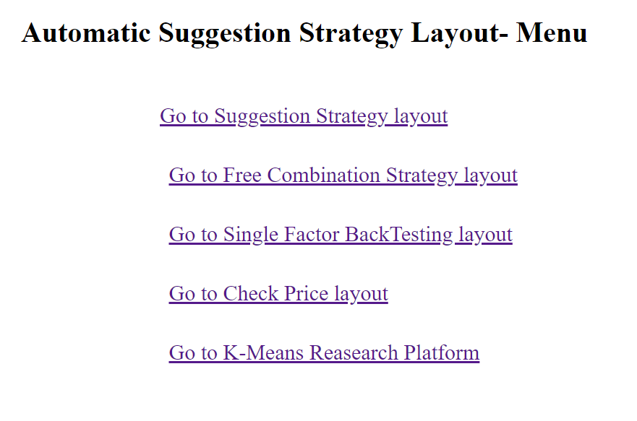
Project Design idea
The whole project can be divided into four main modules and one additional modules.
4 main modules:
- system embedding strategy module (suggestion strategy)
- user free combination strategy module (Free combination Strategy)
- single factor strategy module (single factor back testing)
- multi factor combination module (K-means research platform)
1 additional module
- check prices module (check prices)

Slide 5
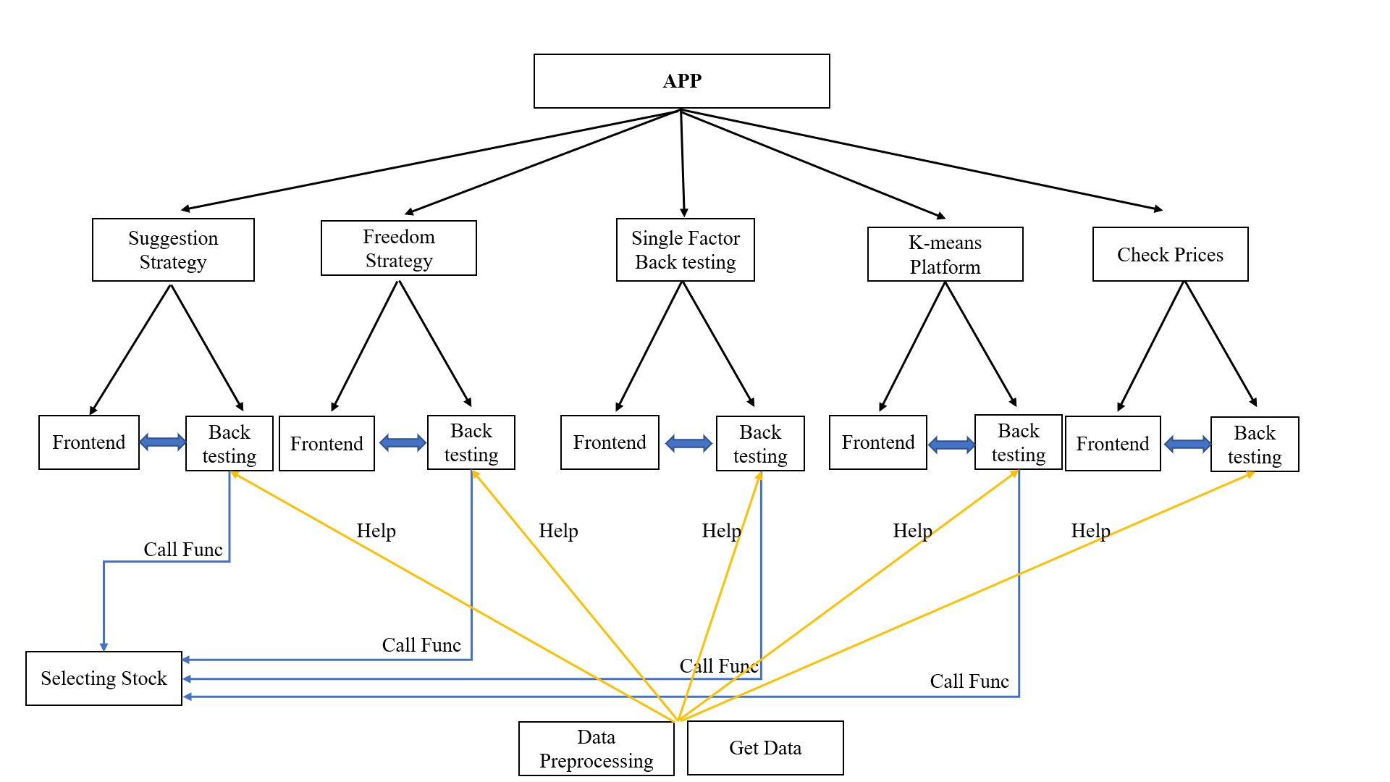
Code Framework
Notes:
Every module could be divided into two sub-modules
- frontend
- back testing
Selecting Stock
- includes different selecting stock methods
Data Processing
- includes tools of the whole project
-e.g., date and exchange code transformation function, read files tools etc.
Get Data
- the codes of getting data from the UQER etc. platform

Slide 6
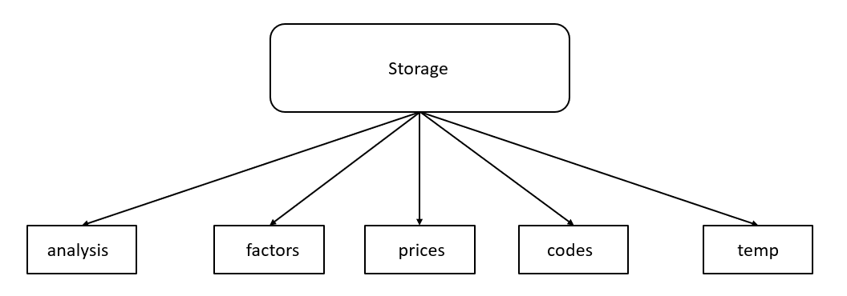
Data Storage Framework
Use CSV files to store data
Notes:
analysis: store the data of after the factors analyzing
factors: store the factors data from 2016-2020
prices: store the stock prices
codes: store the stock codes
temp: this file is responsible to transmit data from the frontend to backend (the data collected in the frontend cannot directly call in other files)

Slide 7
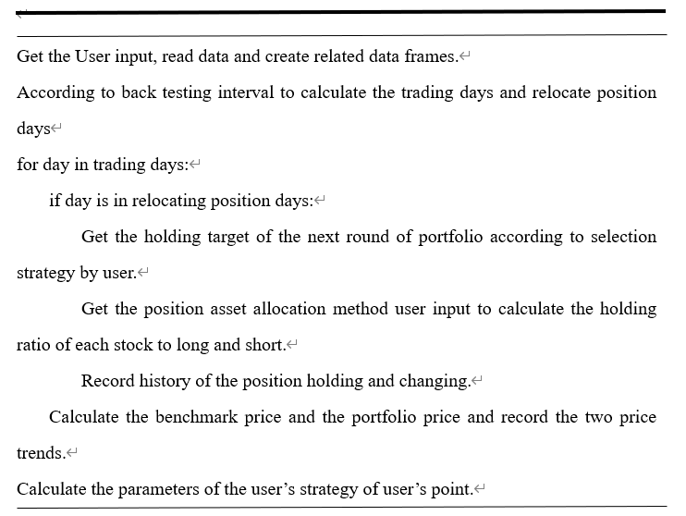
Basic Back Testing Framework
The back testing framework should includes
the key functions which are:
Get the user input from frontend
call methods in select stock
Asset allocation
Long & short stocks
record history
Etc.

Slide 8
Free Combination Framework
Function:
Allow user to make the combination of the portfolio.
User Input Parameters:
Initial cashes
Asset allocation method
Position Frequencies
Portfolio holding in each positioning days
One Operation Designing Idea:
If the user does not make any input on the adjustment day, the system will completely retain the portfolio status of the previous day

Slide 9
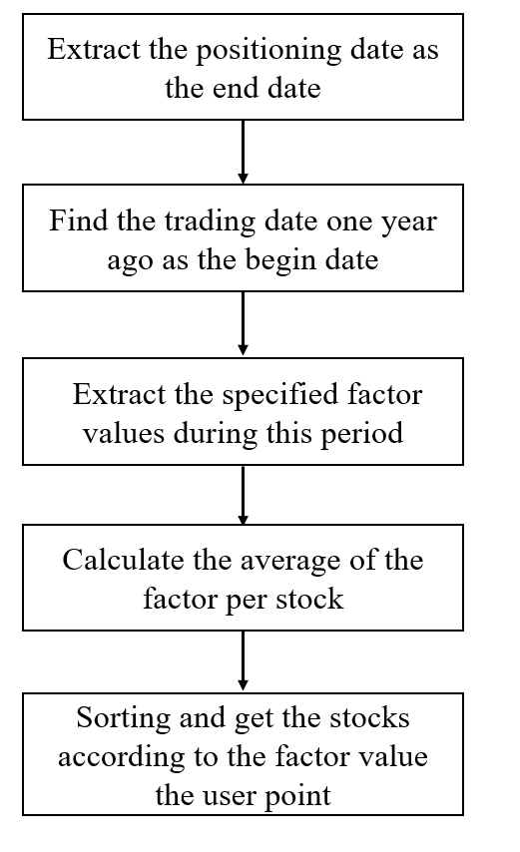
Single Factor Back Testing
Function:
Determine and display the direction of the factors.
Judge the effectiveness of the factors
User Input Parameters:
Initial cashes, frequency, factors
Asset allocation method & Back testing period
Factor values (multiple values)
Factor Values
Step size: 0.1
Range: 0-1

Slide 10
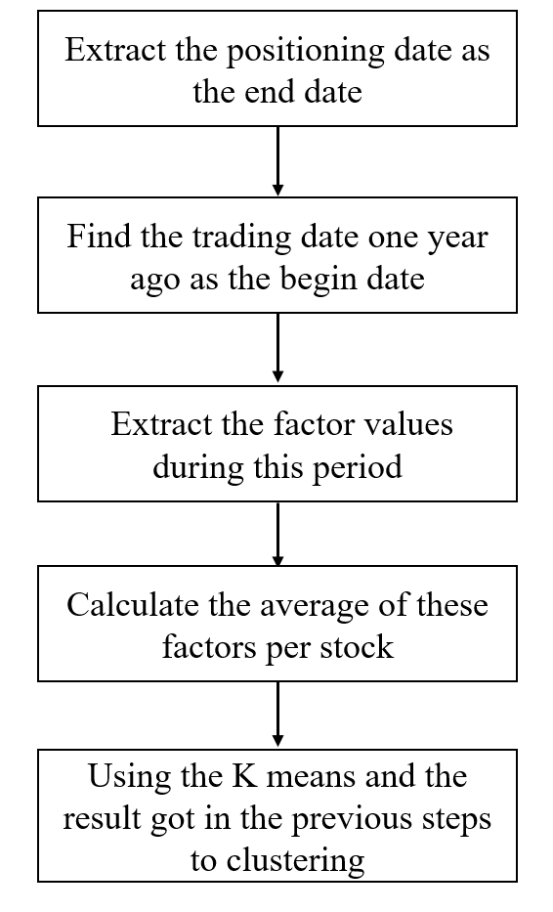
K-means Research Platform
Function:
Use the K means algorithm to cluster the stocks
Show/Research on the performance of the strategy
User Input Parameters:
Initial cashes, frequency
Asset allocation method
Back testing period
K value

Slide 11
K-means Research Platform-Attention
Attention
For this platform, the frequency here pointed the frequency of proportional allocation of constituent stocks within the asset portfolio according to the asset allocation method.
The system should calculate and create the new portfolio quarterly.
Reason
Influence the user interface. Because of the data size and the slow K-means function calculation speed, if call the K- means function too frequent, the speed of back testing will very slow.
There is no need for short-term calling the K-means function. The data of each calculating is from the average value of the previous year, if the training period is short, the stock pool in each cluster will not change significantly.

Slide 12
Details

Slide 13
Suggestion Strategy Framework
This module can be divided into three parts
Factor strategy
Price strategy
Market value strategy

Slide 14
Factor Strategy
The multi-factor quantitative trading model is one of the most used stock selection models. This model can obtain excess returns by actively selecting and managing investment portfolios.
The core of the multi-factor quantitative trading model is that there are many factors in the market, some of which can have a good effect on stock selection in a certain period of time.
Data Preparing and Preprocessing
Single Factor Validation Test
Multi-factor Correlation Analysis and Synthesis
Scoring Method to select stock
Notes:
Predicting which stocks will perform well in the future often requires one or more indicators that we can obtain, linking them with future stock performance, and guiding our investment
For constructing multi-factor model, we firstly do data preparing and processing, and secondly do single factor validation test which contains information coefficient analysis and returns analysis. In the third step, we built the basic model for multi-factor Correlation Analysis and Synthesis. Lastly, we use scoring method to select stock portfolio.

Slide 15
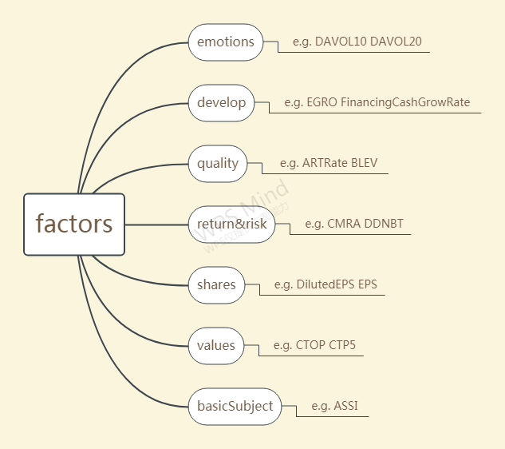
Factor Strategy
Data Preparing and Data Preprocessing
Data preparation
CSI 300 stock as the research object , 211 stocks, 143 factors belonging to 7 different categories
Data cleaning
Remove extremum
Z-score standardization
Neutralization
Notes:
We take CSI 300 stock as the research object, and collected factor as well as price data of stocks.
The factors affecting stock price returns are various, we select the following several types of factors., they are emotions, develop, quality,return&risk, shares,values and basicsubject factor.
·Data cleaning. (we assume that stocks data that were missing at least 50 factors on three consecutive dates are invalid data, so in this step, )we delete 31 stocks which are judged to be missing too much factor information. Then use mean value of factor to fill in the blank. This step is essential for the following PCA processing because the data required by PCA synthesis cannot have null values.
Remove extremum
Not to delete "abnormal data", but to "pull back" these data to normal values.
Z-score standardization
this is refers to Conversion of data into a Gaussian distribution with a mean of 0 and a variance of 1.
` Neutralization
prevent the selected stocks from being concentrated in certain fixed stocks during the back-test of factor stock selection.

Slide 16
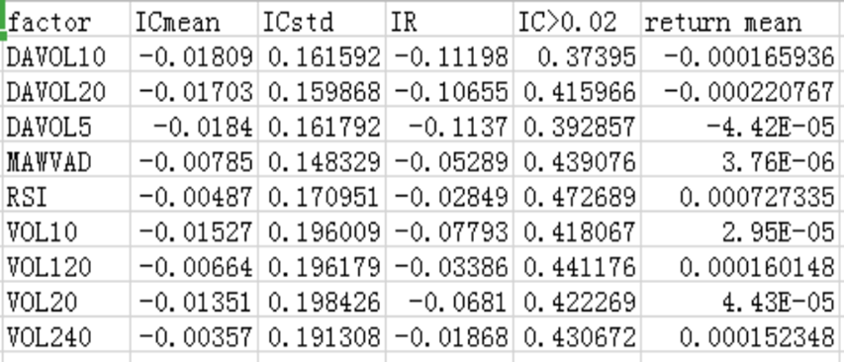
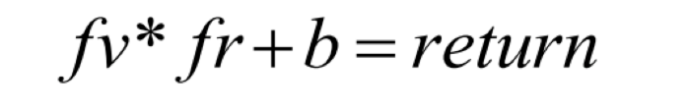
Factor Strategy
Single factor validation test
Filter out the 143 factors that are stable and effective for stock returns
Information Coefficient Analysis
Returns Analysis
Notes:
Single Factor Validation Test conclude two aspects, Information Coefficient analysis and Returns analysis.
Use Alphalens to calculate the IC value of the factor.
Factor return analysis needs to determine the performance of the factor in different stock position.
(The factor return rate is to establish a cross-sectional regression equation between the factor exposure value in a fixed period and the next period's return rate. In this formula, fv means factor value, fr is the obtained weight coefficient meaning factor return rate,)
Table 2 shows part of the calculate result.. when the ICmean is more than 0.005, it can be regarded as an effective factor, otherwise, it is regarded as an invalid factor.
Based on this principle, we delete a few of invalid factors and there remain 98 factors

Slide 17
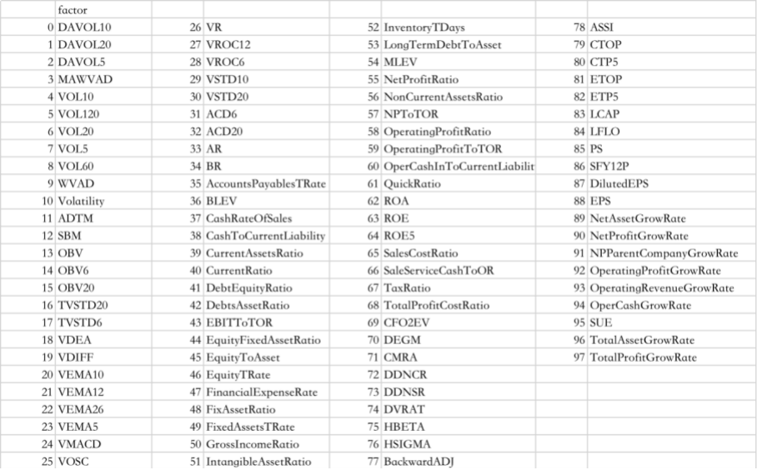
Factor Strategy
Single factor validation test
Apply factor IC and factor return rate to realize single factor testing and back-testing framework for factor screening, and select 94 factors from 143 factors.
Notes:
Apply factor IC and factor return rate to realize single factor testing and back-testing framework for factor screening, and select 94 factors from 143 factors.

Slide 18
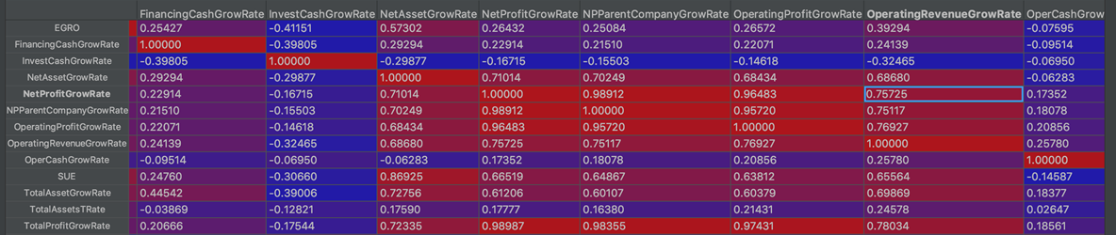
Factor Strategy
Multi-factor Correlation Analysis and Synthesis
Correlation analysis for factors of the same category
PCA synthesize different types of high-correlation factors separately
Also keep factors that have not been synthesized due to their weak correlation to other factors , putting them together, finally getting 33 factors.
Notes:
Do Correlation analysis for factors of the same category. Correlation analysis is an IC sequence analysis of factors.
Then establish factor correlation tables and high correlation factors were screened by factor correlation. A series of factors with a correlation coefficient greater than 0.5 were selected for PCA synthesis。

Slide 19
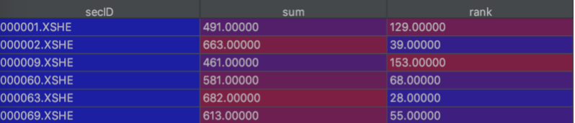
Factor Strategy
Scoring Method
Select 8 factors obtained by PCA synthesis for scoring method. Score these factors of each stock
Sum the score obtaining the total score and rank stock according to the total score
The trading rule is to adjust the position once a day and sell the stocks already held, buy stocks in the new stock pool.
Notes:
The multi-factor scoring stock selection model is to give relevant scores to the factors that affect the stock price and then sum the score obtaining the total score.
（Select 8 factors obtained by PCA synthesis which are valid and stable for scoring method and determine the direction of factors.
Sort and score the values of the eight factors of each stock. If the direction of the factor is negative, the smaller the factor is, the greater the yield is and the larger the score is.
The scores of the eight factors of each stock are added up equally to get the total score of each stock, and the stocks are ranked according to the total score.）

Slide 20
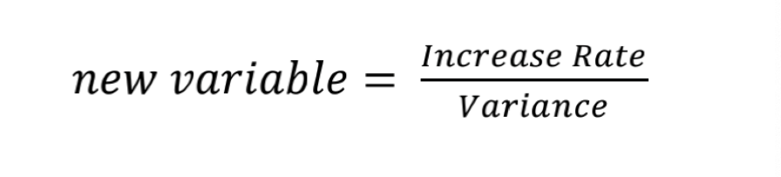
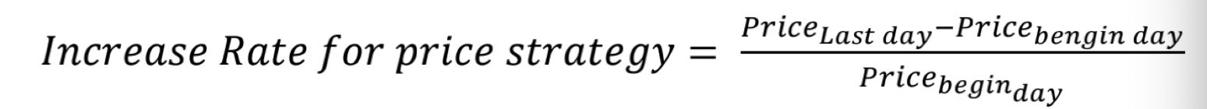

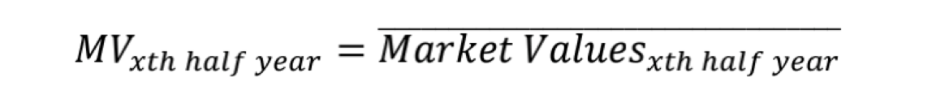
Price Strategy & Market Value Strategy
New Factor Defined
Notes:
Brand new factor our member define
There are two reasons for this definition
For price strategy, there is currently a financial market hypothesis that the current expectations of stocks reflect the impact of all the information they have suffered.
For market value strategy, since the market value does not have a strong summary characteristic similar to the stock price, the project divides the market value into two parts, hoping to find a stable growth stock. Stable growth means that the stock’s historical volatility is small and the increase rate is large.

Slide 21


Price Strategy & Market Value Strategy
Price Strategy
After determining the adjustment date, the price data of the year before the adjustment date will be extracted, and the extracted data will be used to calculate the defined factor value.
Each round the system will select the top-ranked stocks for this factor. The selected portfolio will be the target of this round of adjustment.
Notes:
After determining the adjustment date, the price data of the year before the adjustment date will be extracted, and the extracted data will be used to calculate the defined factor value.
Each round the system will select the top-ranked stocks for this factor. The selected portfolio will be the target of this round of adjustment.

Slide 22


Price Strategy & Market Value Strategy
Market Value Strategy
Calculates the factor defined in the project, and sort the stocks according to the size of the factor, at last, select top-ranked stocks according to the factor in each repositioning cycle to form a new round of portfolio.
Notes:
Calculates the factor defined in the project, and sort the stocks according to the size of the factor, at last, select top-ranked stocks according to the factor in each repositioning cycle to form a new round of portfolio.

Slide 23
Asset Allocation Method
Two methods in the system to calculate the ratio of positions and the share of long and short.
Equal Weight Method
The total assets are distributed using an average method
2. Market Value Weight Method
System reads in market value data and matches it according to the market value of each stock
The larger of market value, the more of the proportion in the new portfolio
Notes:
After determining the stocks held in this round through the embedded strategy, the system needs to determine the asset allocation according to the asset allocation method specified by the user. （In these methods, it is necessary to adjust the positions of the portfolios already held and determine the buying and selling shares to achieve the holding goals of this round. ）There are two methods in the system to calculate the ratio of positions and the share of long and short, namely equal weight method and market value weight method.
Equal
In this method, the total assets （currently held by investors are calculated, and the total assets ）are distributed using an average method, （which is using the total asset divide the size of new portfolio, to determine the ratio of each stock to achieve this round of investment portfolio goals. ）
Market Value Weight Method
In this method, the system reads in the market value data and matches it according to the market
value of each stock. The larger of market value, the more of the proportion in the new portfolio,
（otherwise, the smaller of market value, the less of the proportion）

Slide 24
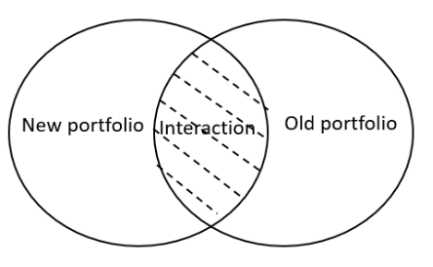
Asset Allocation Method
Asset Matching Adjustment
Stocks appear on the new portfolio and old portfolio lists
The stock only appears in the new portfolio but not in the old portfolio list
The stock only appears in the old portfolio but not in the new portfolio list
Notes:
When calculating the share of longs and shorts to achieve this round of target matching, it needs to be divided into three situations for discussion.
Stocks appear on the new portfolio and old portfolio lists : compare whether the shares in new round exceed that in the previous round.if the shares in new round exceed that in the previous round, add the stock to the long list,and the weight behind is（ total asset divided by length of ）new portfolio shares minus shares in old portfolio. （If not exceed, add the stock to the short list and the weight behind is share in old portfolio minus（ total asset over length of） new portfolio shares.）
The stock only appears in the new portfolio but not in the old portfolio list: add to long list （The weight of stock is the（shares of total asset divided length of new portfolio））
The stock only appears in the old portfolio but not in the new portfolio list: Add the stock to the portfolio short list and the weight behind is shares in old portfolio

Slide 25
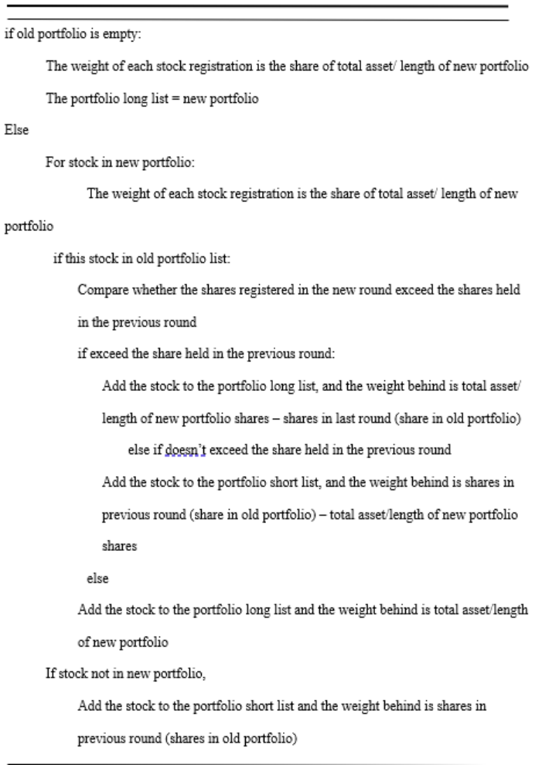
Asset Allocation Method
Asset Matching Adjustment
Assume the assets can be divided indefinitely
Get two tables(lists) stored in hands. Long list shows the stocks and shares we need to buy in the new round of holding the portfolio, short list shows the stocks and shares of the portfolio we need to sell.
Notes:
Finally get two tables(lists) stored in hands they are Long and short list.

Slide 26
Demo

Slide 27
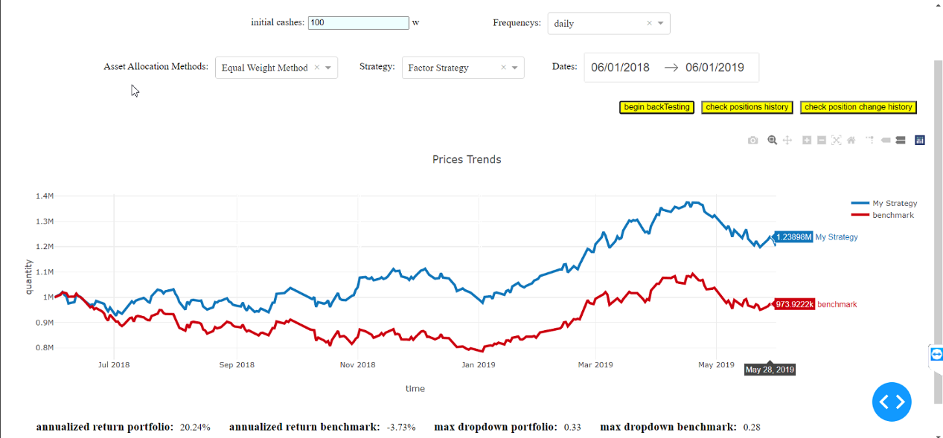
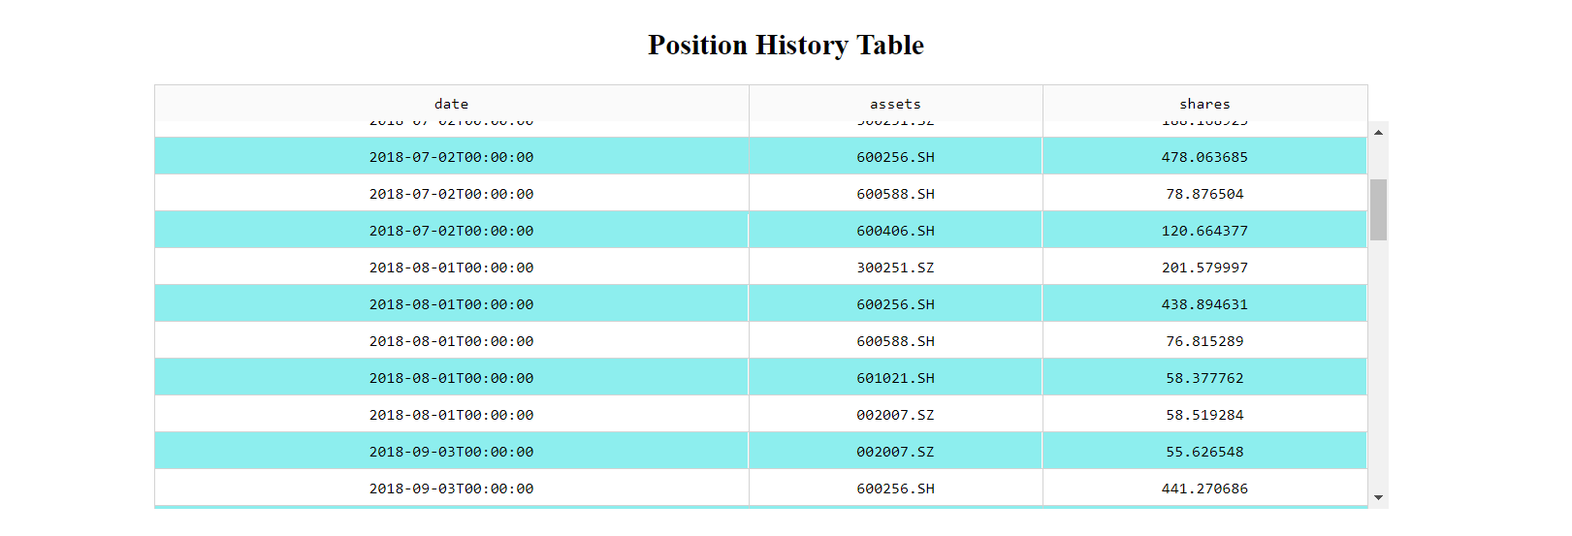
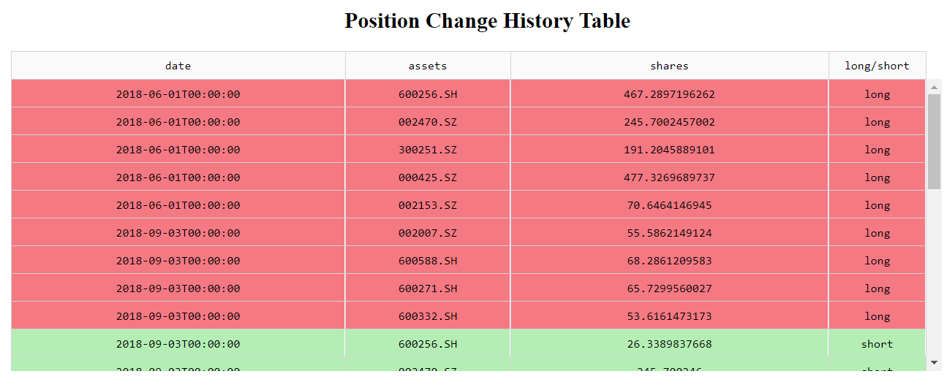
Result-Suggestion Strategy

Slide 28
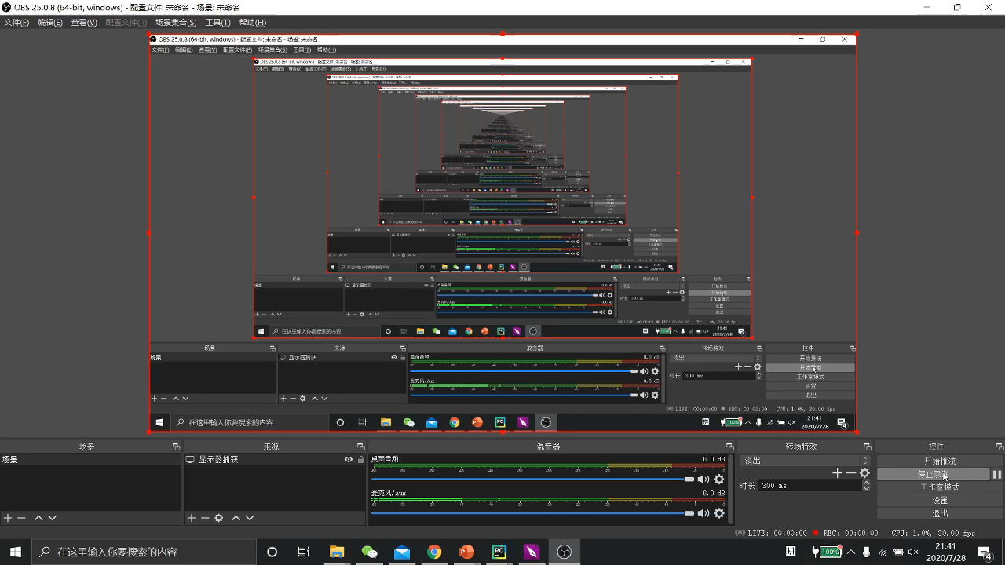
Result-Suggestion Strategy

Slide 29
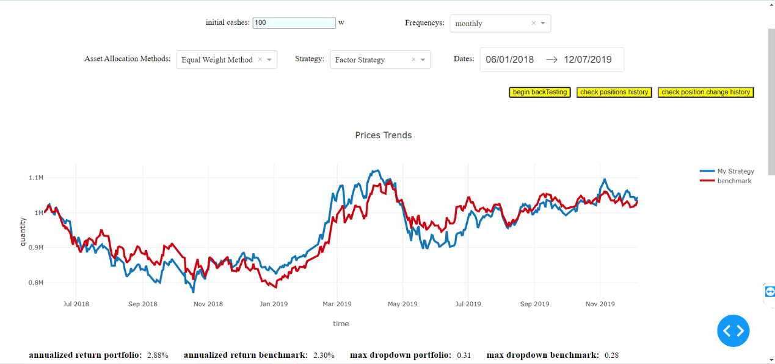
Discussion-Suggestion Strategy

Slide 30
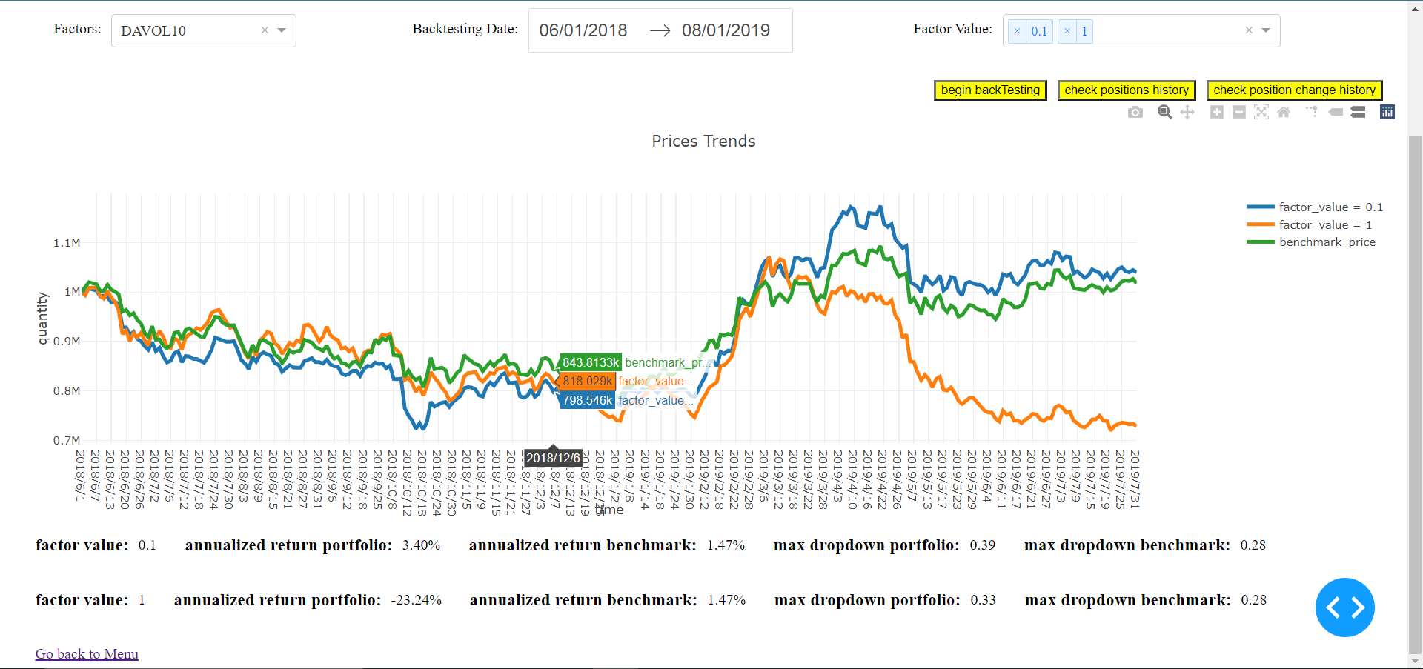
Result-Single Factor Back-testing

Slide 31

Future work

Slide 32
Discussion-Single Factor Back-testing
Comparing and analyzing the portfolios with factor values in the bottom 10% and the portfolios with factor values in the top 10%, it can be found that the direction of a single factor changes in different time periods. Specifically, for the DAVOL10 factor selected in the example above, before February 2019, the larger the factor value, the higher the annualized rate of return. After this point in time, the factor direction has changed, and the factor value smaller, the higher the annualized rate of return.

Slide 33
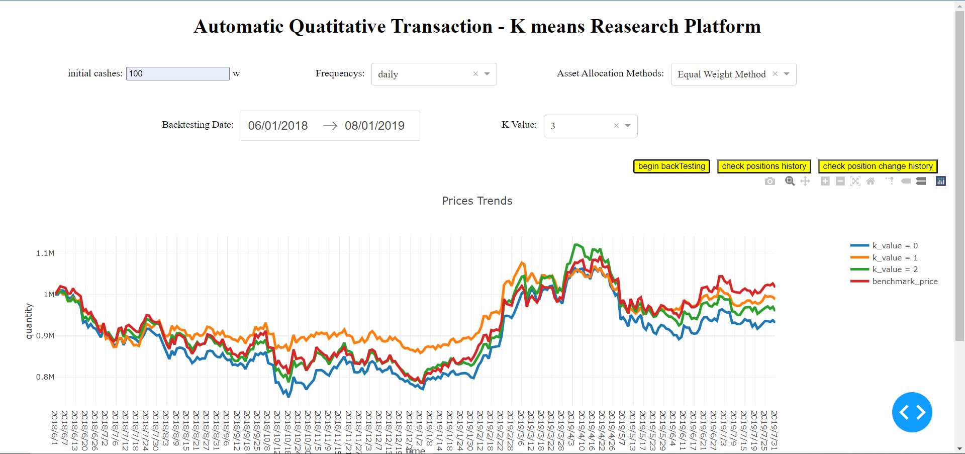
Result-K-means

Slide 34
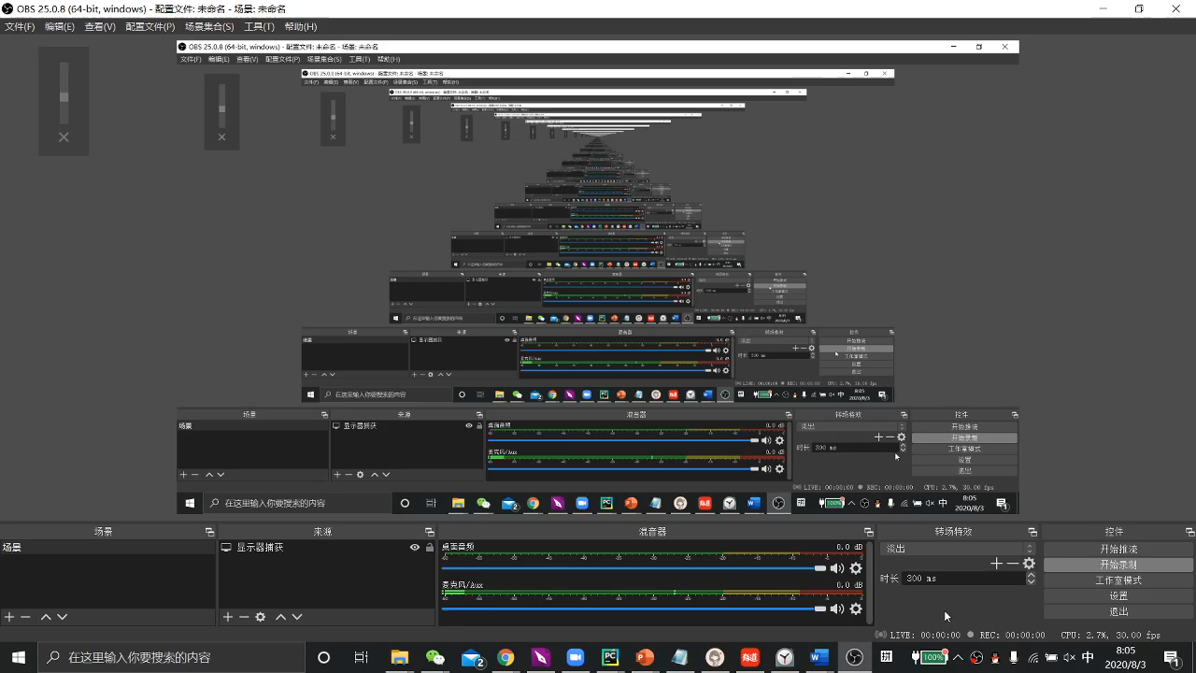
Future work

Slide 35
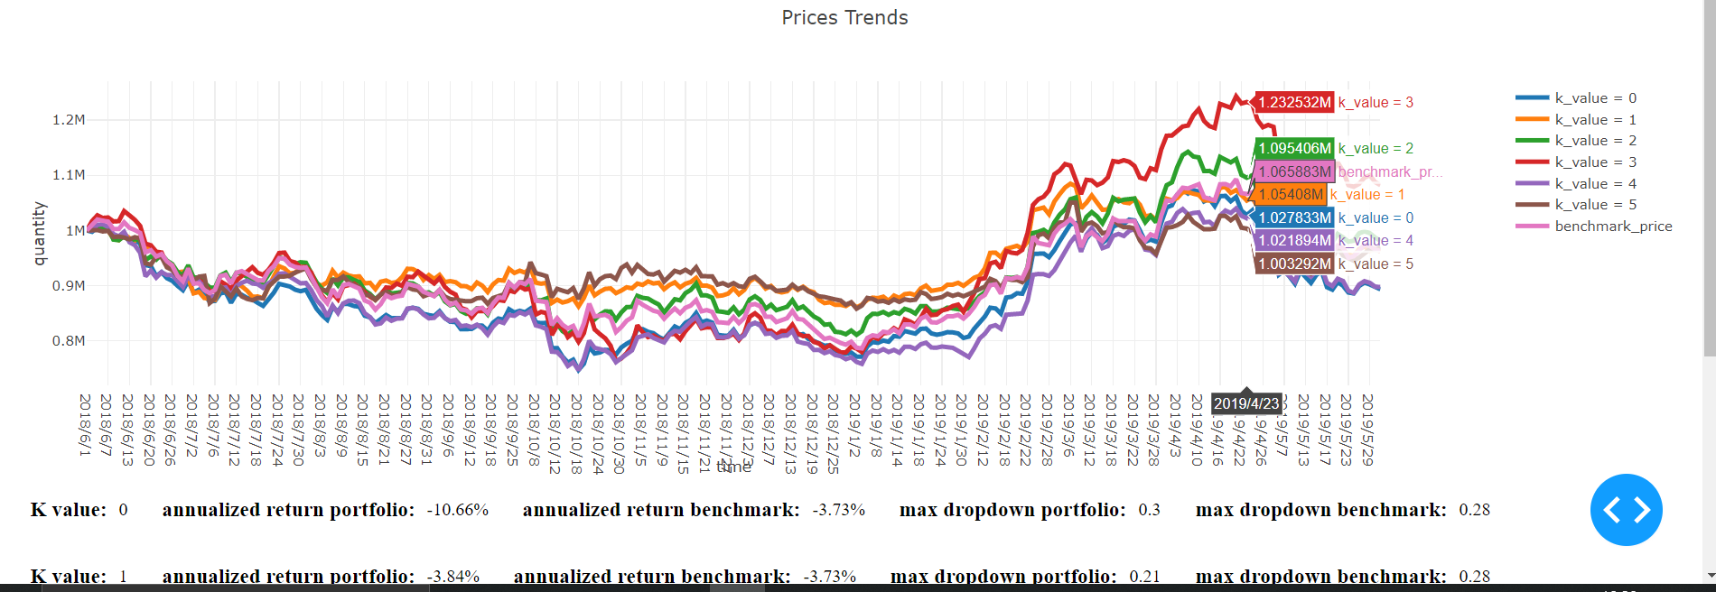
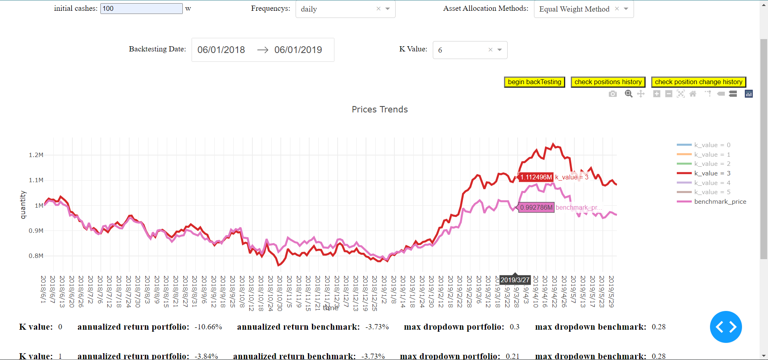
Discussion-K-means

Slide 36
Conclusion

Slide 37
Conclusion
In general, users can use the quantitative trading strategy in the system to select asset portfolios, asset allocation, back-testing, and query historical transactions and positions. The multi-factor stock selection strategy in the system can outperform the market, and user can refer to our strategy. In addition, the system also provides users with custom asset portfolio verification to help users quickly verify the correctness of their ideas, effectively reducing the user's decision-making risk. Similarly, the system also provides a single-factor back-testing framework. Of course, the system also has imperfections. The investment portfolio selected by K-means strategy has many situations where it cannot beat the market, and this is a point that need to be optimized in the future.

Slide 38
THANK YOU

Slide 39
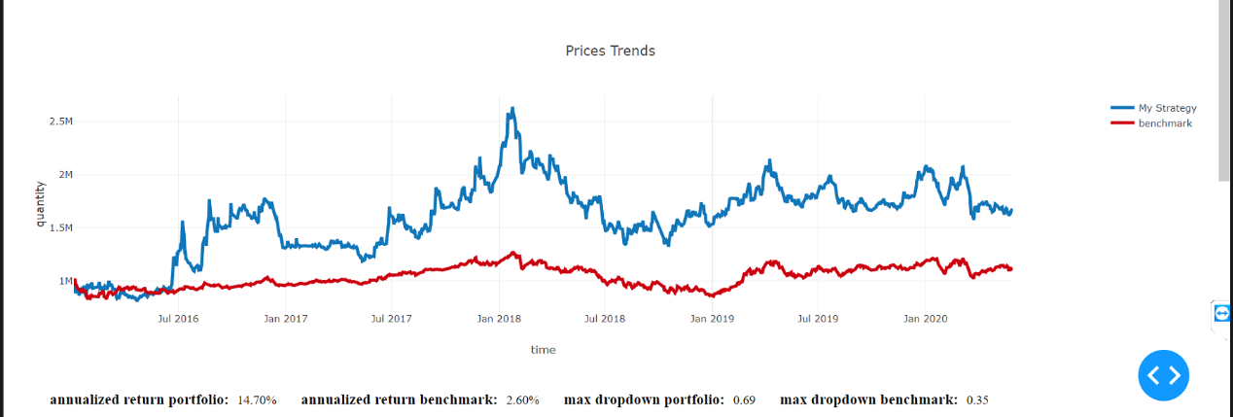
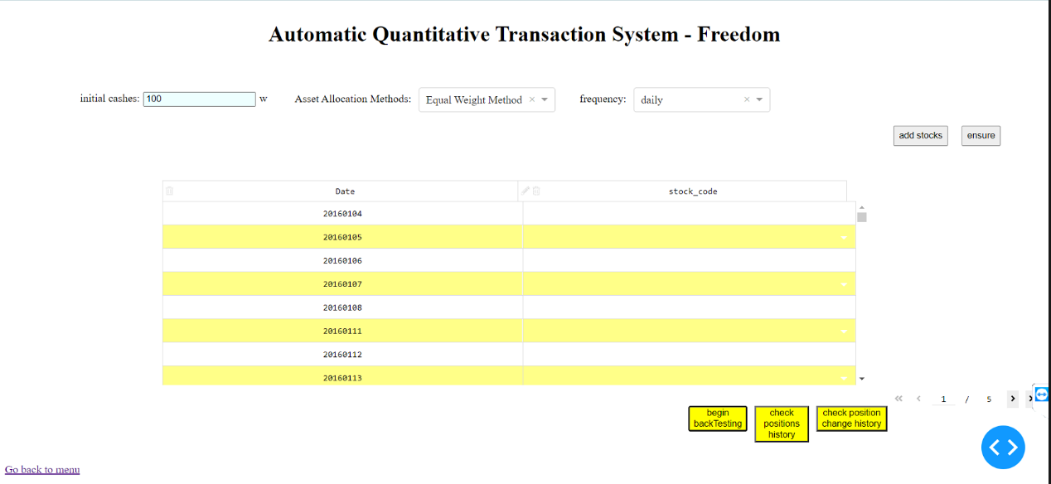
Result-Free Combination Strategy

Slide 40
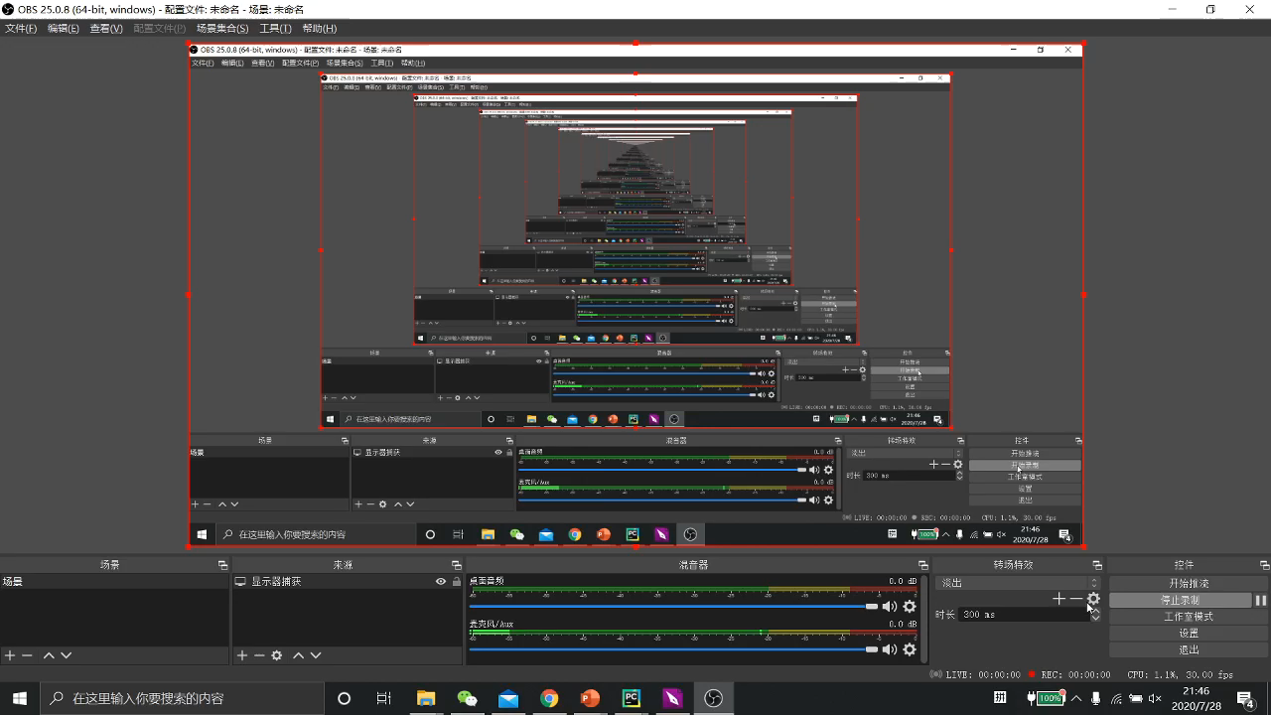

Slide 41
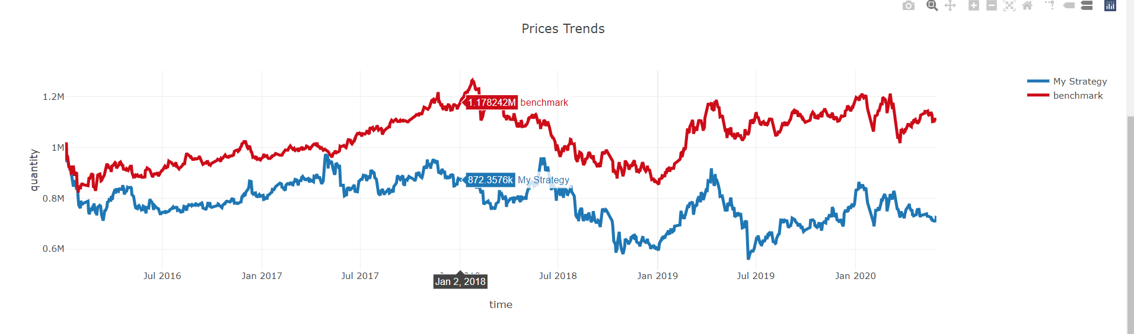
Discussion-Free Combination Strategy

Slide 42
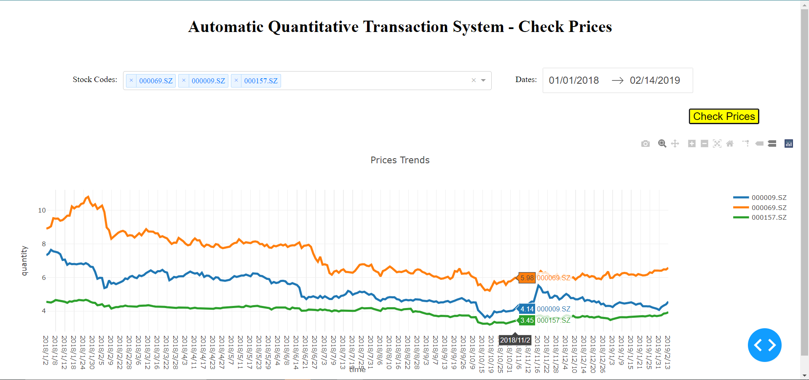
Result-Check Price

